Slide 1
Dalai Java SEPR

Slide 2
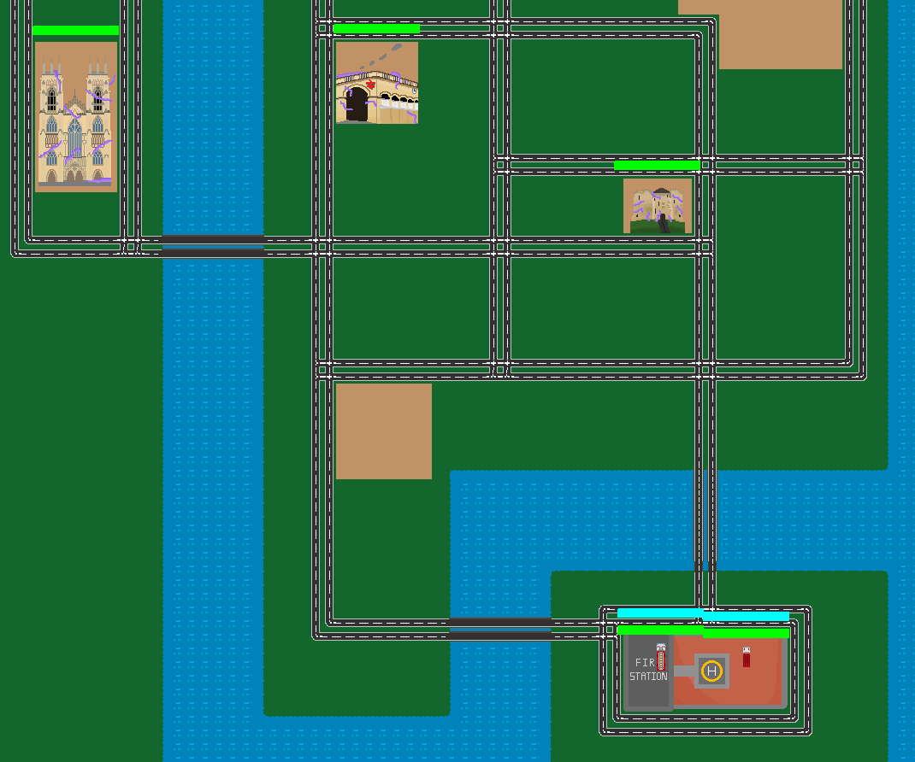
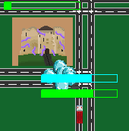
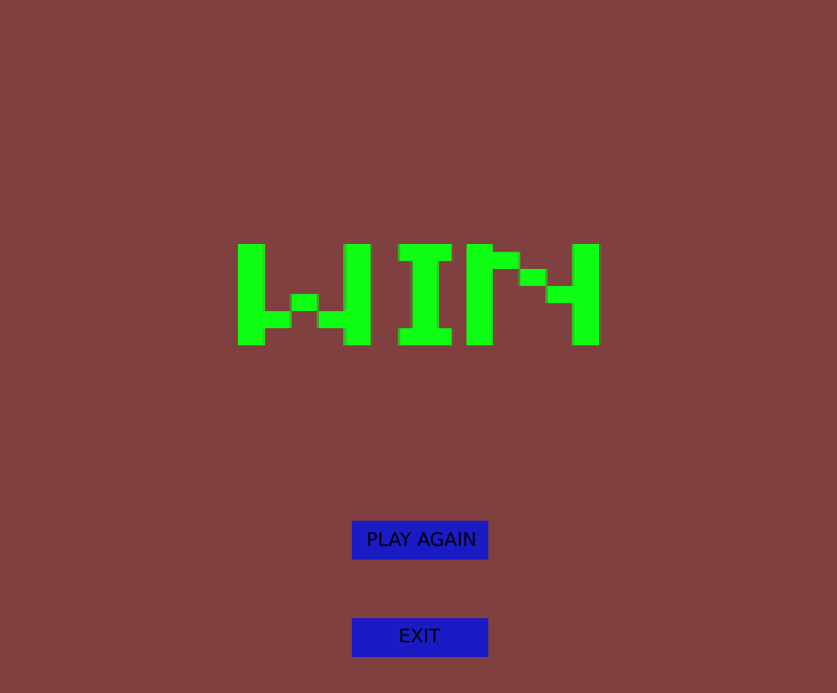
The Product
Complete working game with two Fire Engines and three Fortresses
Start screen, pause screen and game over screen all implemented
Fire Engines can aim at the fortresses using the cursor
Working Win / Lose screen
Screen can be dragged up and down

Slide 3
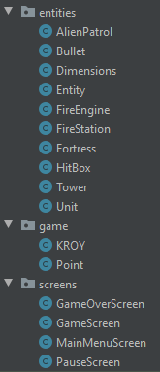
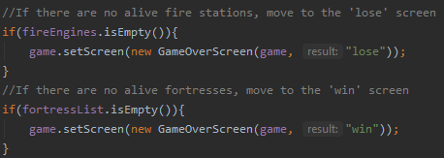
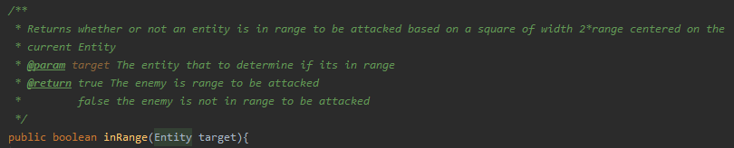
The Code
Code neatly organised into classes
All code is well-documented with comments and docstrings

Slide 4
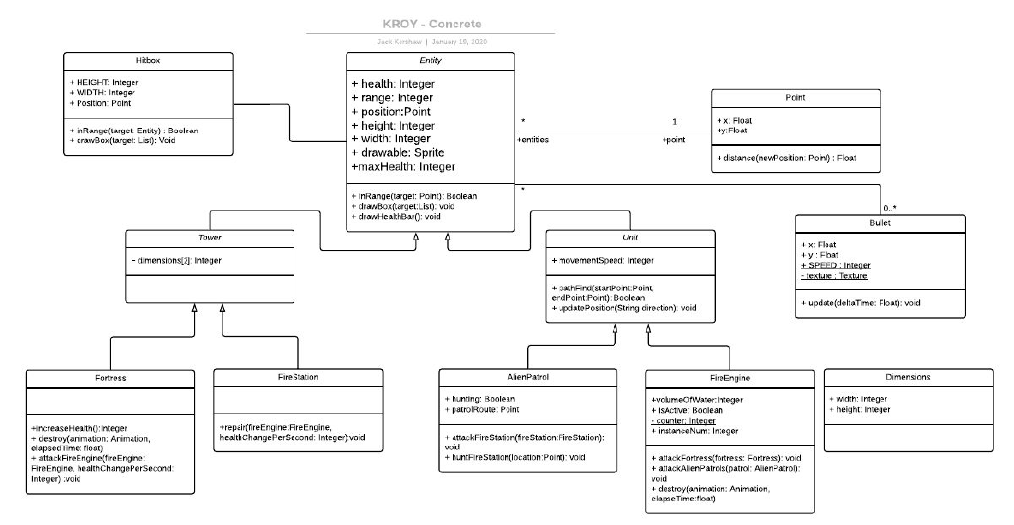
The Architecture
Clear concrete UML architecture
Links to relevant requirements

Slide 5
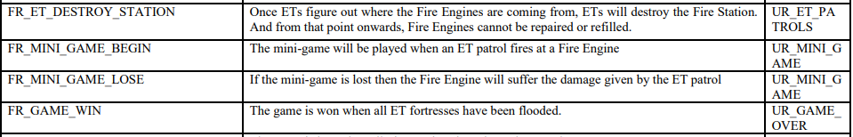
The Requirements
Well-defined User Requirements
Clear links between Functional and User requirements
Precise Fit Criteria for Non-Functional Requirements

Slide 6
The Architecture
Clear concrete UML architecture
Links to relevant requirements

Slide 7
The Architecture
Clear concrete UML architecture
Links to relevant requirements

Slide 8
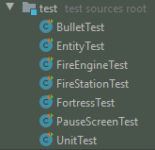
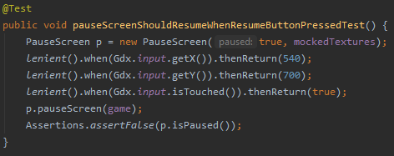
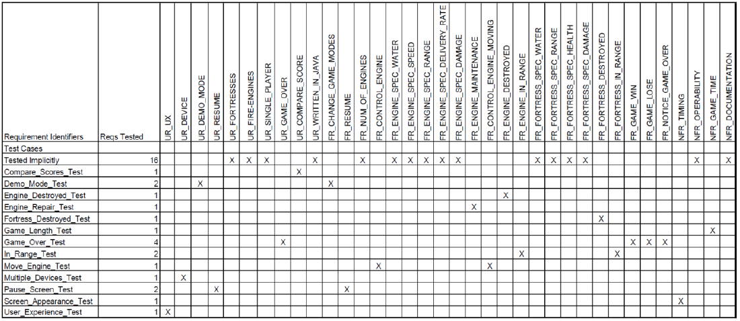
The Testing
Well-defined Unit Tests for each class
Intuitively named tests
Clear cross-referencing between tests and requirements

Slide 9
Visit our site
https://baffledwhiskey.github.io

